Slide 1
PREDICTION OF LUNAR EFFECT USING MACHINE LEARNING
Rakshita Kaushik 211153
Ashika Minhas 211316

Slide 2
PROBLEM STATEMENT
Do Lunar Phase Effect The Phenomenon On Earth ?
Can The Machine Learning Techniques Be Applied To Predict The Phenomena On Earth ?

Slide 3
AIMS AND OBJECTIVE
Aim - : To Predict The Earthquakes Magnitude And Birds Migrations For Lunar Phases and finding correlation among them .
Objective -: Finding Best Model For Predicting The Earth’s Magnitude , Migration Of Bird Wrt Moon Phase.

Slide 4
LITERARY REVIEW
S no. | Paper Title | Journal conference year | Results | Limitations
1 | The lunar cycle drives migration of a nocturnal bird" | 2019 | The daily fraction of travelling nightjars increased during full moons | lack information about feeding success and daily fuelling rates in relation to moon phases
2 | Celestial moderation of tropical seabird behaviour | 2011 | nocturnal illumination is an important factor influencing the predator/prey interaction | no clear correlation between initiation dates of pre- and post-breeding migrations and moon phases
3 | chronobiology by moonlight | 2013 | moonlight confers information that is being used by diverse species as a cue for example eagle owls, nightjars | no clear correlation between initiation dates of pre- and post-breeding migrations and moon phases
4 | he effect of earth tides in triggering earthquake as clearly observed in some specific regions of Japan | 2012 | specific lunar phases creates effective tidal forces that fault for triggering earthquakes | The occurrence of earthquakes is thought to be accidental; thus the occurrence time is arbitrary
5 | Gravitational Moon–Earth Forces Triggering Earthquakes in Subduction Zones | 2016 | The energy from the higher tides causes enough stress to disrupt the region to trigger the largest earthquakes | the Moon and the Earth connection have interactions that require long time intervals to affect largest seismological events

Slide 5
PROJECT FEATURES
The Project Is Divided Into Two Parts
Part - 1 : For The Prediction Of Magnitude Of Earthquake Wrt To Moon Phase.
Part -2 For The Prediction Of Bird Flight Wrt days before full moon

Slide 6
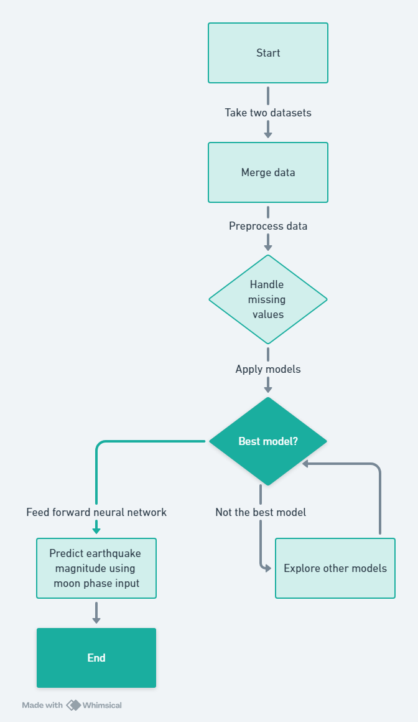
Flow chart for the prediction of Magnitude

Slide 7
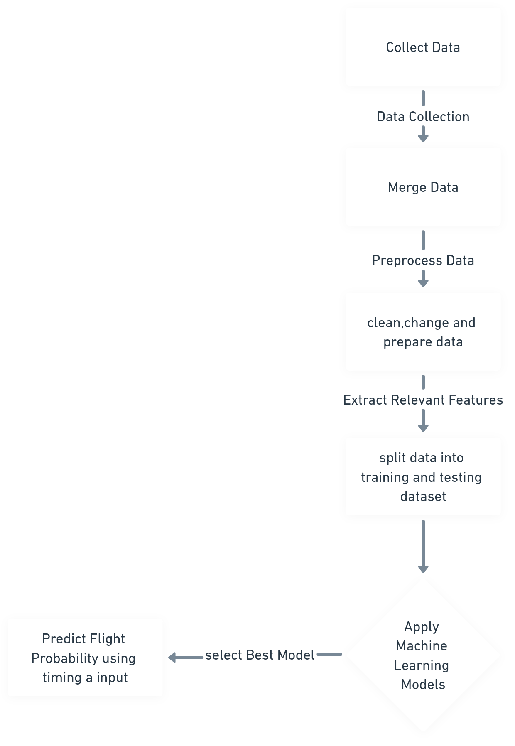
Flow chart for the prediction of flight

Slide 8
PROJECT FEATURES
Data Set Used For Part-1
Time Series Data : For part 1 - Consisting Of Moon Phase , Dates , Time Of Moonrise And Moonset For A London .
Seismic Data : Consisting Of Earthquake’s Dates , Magnitude , Depth , Magnitude Type longitude and latitude .
Time Series Data : For part 2 - Consisting of number of flights per bird per day
Event Data : Contains Id of bird, region and season during flight, duration of observation, timing and exp. timing(number of days from the new moon)

Slide 9
PROJECT FEATURES
Data Preprocessing For Merged Data Of Earthquake And Moon Phase
Handling The Missing Values In Merged Data In The “Phase” By Applying Lunar Formula
Once Missing Value Is Handled , Numerical Encoding Is Done For Every Moon Phase And New Column “ Moon_phase_numeric” Is Generated

Slide 10
PROJECT FEATURES
Data Preprocessing For Merged Data Of flight data and event data
Convert date column into date time format
One hot encoding is done to convert non numerical data to numerical data
Scale numerical data

Slide 11
PROJECT FEATURES
Splitting The Dataset Into Training And Testing Dataset
For part 1
Independent Variable : “moon phase numeric “ as X
Dependent Variable : “ Magnitude” as Y
For part 2
Independent Variable : “timing after scaling” as X
Dependent Variable : “Flight” as Y

Slide 12
PROJECT FEATURES
Training and evaluation of model
Various regression models were applied for finding the best possible results -:
feedforward neural network,
Random Forest
Support Vector Regressor
Gradient Boosting Regressor
Ridge Regression
K-Means
Linear regression
For part 1
Out of among all feed forward neural networks were best with RMSE Of 0.190 by using Epochs of 100 .
For part 2
Out of all machine learning models random forest were best with MSE of 0.0521.

Slide 13
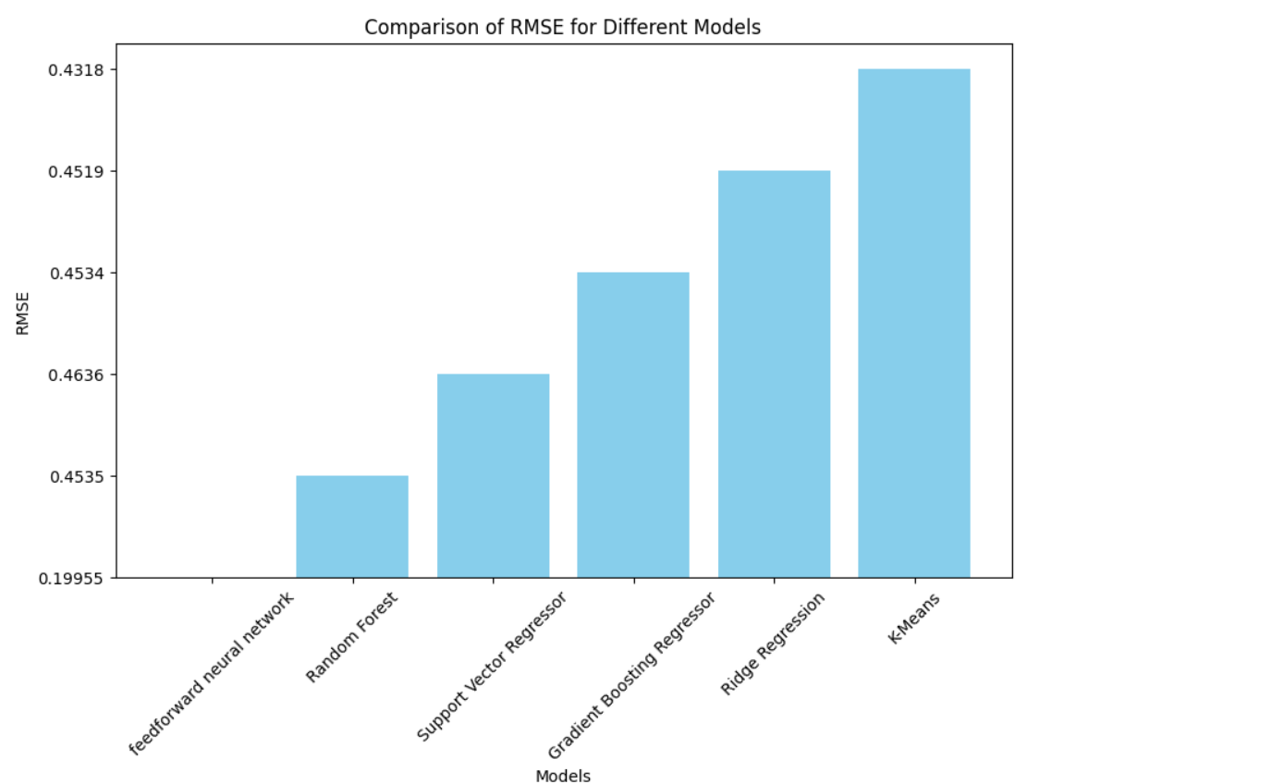

Slide 14
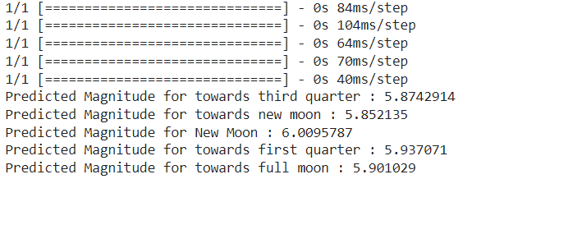
PROJECT FEATURES
Prediction Of Earthquakes Magnitude Using FNN

Slide 15
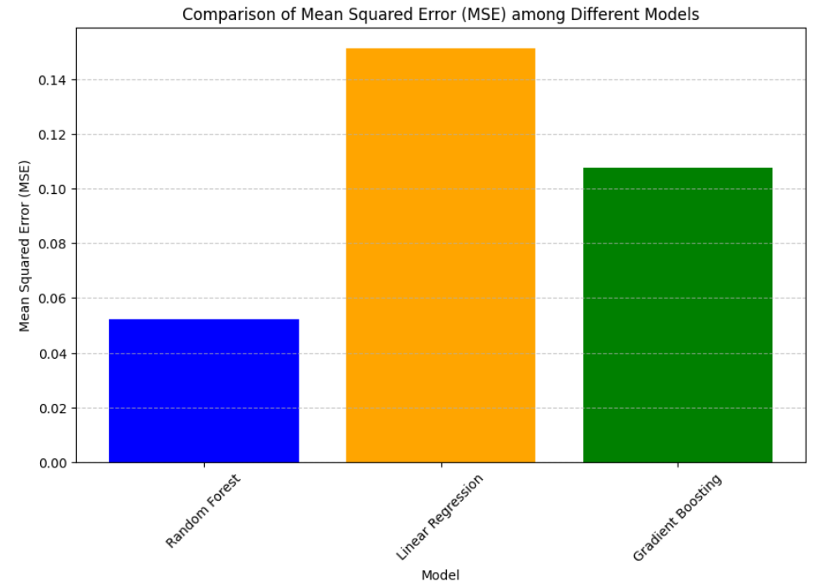

Slide 16

PROJECT FEATURES
Prediction Of Probability of flight using Random Forest
Taking number of days before full moon as input

Slide 17
SIGNIFICANCE OF PROJECT
THIS PROJECT CAN BE APPLIED TO VARIOUS FIELD LIKE SEISMOLOGY AND ORNITHOLOGY.
Seismology -: Prediction Can Be Done To Know The Magnitude In Earthquake Prone Region To Calculate The Risk , So That Necessary Measures Can Be Taken For Minimal Public Losses .
Ornithology -: Predictions Can Inform Decisions To Temporarily Shut Down Lights And Wind Turbines, Halt Gas Flares, Choose Airplane Flight Paths, And Take Other Actions To Prevent Human And Avian Mortality , Also It Can Be Good For Agriculture Purpose .

Slide 18
FUTURE WORK
Future work -:
Considering Location Factor Can Be Done For More Accurate Model Working
Also Other Geographical Phenomena Like Tsunami , Tidal Length Can Be Predicted For The Very Purposes .
Bird Flight Can Be Predicted On The Basis Of Dates , Considering The Season Also

Slide 19
Any suggestions ?

Slide 20
Thank you !

